Slide 1
Topic: Data Models

Slide 2
Table of content
Data models
Hierarchal model
Network model
Relational Model
ER (Entity Relationship) Diagram in DBMS
Interview Questions with answers
Multiple choice Questions

Slide 3
Data Models
Data model is the modelling of data description , data semantics and consistency constraints of the data.
It defines how actually data is processed , accessed and stored in the system.
It is the logical structure of the database.

Slide 4
HOW DATA IS CONNECTED TO EACH OTHER LOGICALLY
HOW ABSTRACTION IS INTRODUCED.
HOW THEY ARE PROCESSED.

Slide 5
Hierarchal model
This model organizes data into tree like structure.
There is a single node at the top called as the root node , to which all the other nodes are linked.
The tree structure record the data as parent- child relationship.
In this model , child node will have a single parent node.
This relation of parent-child is 1:N relationship between two record type.

Slide 6
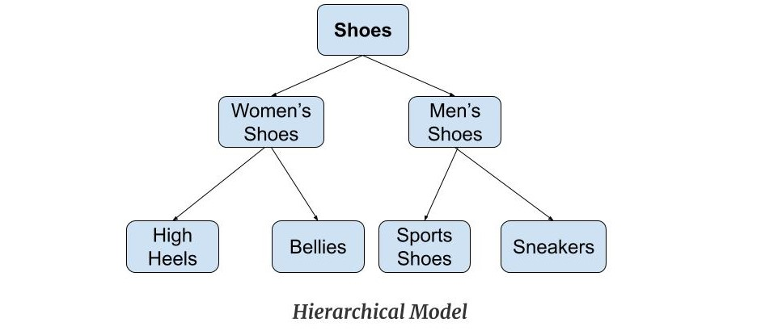
Each child node can have a single parent node only where as a parent node can have one , more than one or no child at all .

Slide 7
Exercise
Create a database consisting of three records-
Books (book_id,book_title,price,author,publisher)
Shopkeeper (shop_id,shop_name,phonenumber,city)
Books_order (book_id,shop_id,quantity)
Create hierarchal tree structure of the above database.

Slide 8
Operations on hierarchal model
Insertion operation
Deletion operation
Updation operation
Retrieval operation

Slide 9
Advantages
It manages large amount of data.
It improves data sharing.
It is very efficient to handle large number of transaction.
Many children per parent.
It have many different structures and forms.

Slide 10
Disadvantages
One parent per child.
Data independence.
It is difficult to manage and expand.
Many to Many relationship not supported.

Slide 11
Network model
Extension of hierarchal model.
In this model , data is organized more like a graph.
More than one parent are allowed in this model.
For example: A book database where an author can have many books and a book can have more than one author.

Slide 12
Operations on network model
Insertion
Deletion
Updation
Retrieval

Slide 13
Advantages
It is simple and easy to design.
The network model can handle the one to many and many to many relationship.
The data access is easier and flexible than the hierarchal model.

Slide 14
Disadvantages
It is more complicated than hierarchal model.
Its structure is complicated.
Its design is not so user friendly.

Slide 15
Relational Model
This model represents how data is stored in relational databases.
It stores data in the form of tables.
It is widely used as it can easily represent most of real world objects and relationships between them using tables.

Slide 16
Various terminology
Relation
Tuple
Attribute
Domain
Cardinality
Degree

Slide 17
Various keys
Primary key
Candidate key
Super key
Foreign key
Alternate key
Composite key

Slide 18
Operations on relational model
Insert
Update
Delete
Select

Slide 19
Advantages
It is simpler than network and hierarchal model.
It is easy to design and implement at the logical level
Relational database is only concerned with data and not with the structures , which improves performance.
It provides flexibility that allows easy changes to database structure.
They are strictly defined and well organized so data does not get duplicated.

Slide 20
Disadvantages
It consumes a lot of memory due to rows and columns.
It has limited ability to deal with large object.
Not suitable for huge databases.

